Slide 1

Year 5 Alton Castle Meeting
Academic Year 2026-2027
Thank you for supporting your child’s education.
Together, we can ensure that children at St Mary’s Catholic Academy achieve their full potential.

Slide 2

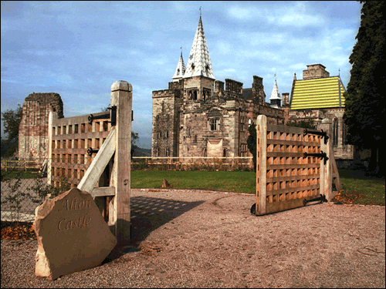
Monday 12th-Wednesday 14th November 2026

Slide 3
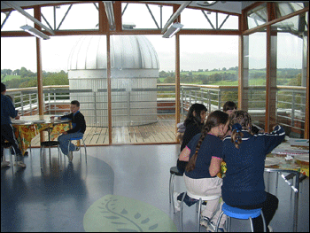
History
Alton Castle opened in September 1996 as a Catholic residential retreat centre for young people. It has had a highly successful first few years with over 8,000 children visiting the Castle each year.
Its popularity can be put down to the fact that the Castle offers a unique experience for our children, in terms of promoting their spiritual and social growth.

Slide 4
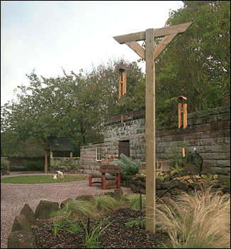
What is Alton Castle?
It is a Registered Catholic Retreat Centre specialising in the personal, spiritual and social development of children.
Alton Castle is an amazing building, and the children can experience its magnificent towers, Gothic arches, wonderful stonework and turreted views over the Churnet Valley, whilst being given time for personal fulfilment and social interaction with their classmates

Slide 5
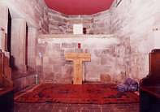
Why do we take our children?
We believe that Alton Castle will provide our children with a unique personal, spiritual and social experience, giving them opportunities and skills beyond the curriculum
It is a 3-day journey of laughter, self-discovery and bonding, which will hopefully bring them closer to each other and to God.

Slide 6
The Staff
A vibrant, largely young team of people staffs the Centre. Some are qualified youth workers, activity instructors, catering and administrative staff.
They are highly motivated by their desire to work with children, develop their own skills and faith, and provide a unique and memorable experience for the children.
They bring with them their musical talent, enthusiasm, sporting skills and deep commitment to children and to God. They provide excellent role models and work well alongside teaching staff.

Slide 7
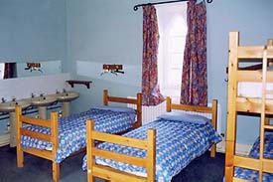
Accommodation
The building accommodates 75 young people, plus teachers.
We will be sharing with other schools from the collegiate.
The beds are arranged in dormitories. We will organise the children into their dormitories prior to our visit, so that the children will stay with their friends. They children will not be sleeping in the same dormitories as children from other schools
Males and females are on separate floors, manned by the teaching staff.
Children are required to bring either a sleeping bag or a duvet. All other bedding is provided.

Slide 8
Food & Meal Times
Meal times at Alton Castle are an important social event!
Children are expected to dine together, say grace before and after meals together, and not leave until everyone has finished
The quality of food is excellent, offering a good choice of hot, substantial meals, including vegetarian options
Please inform teaching staff if your child has a specific dietary requirement

Slide 9
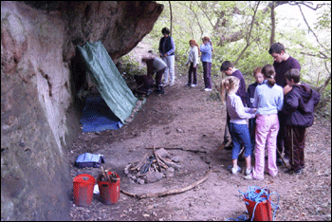
Programme of Events: Day 1
Arrive at Alton Castle in the afternoon.
Show children to their dorms and explain house rules
Ice-breaker / music session- getting to know each other
Group children into activity groups (4 or 5 children from each school per group)
Evening meal
“Finding your way around” activity
Nightly prayer service/ reflection

Slide 10
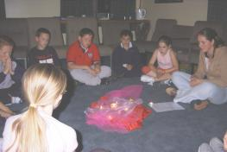
Programme of Events: Day 2
Children will complete 2 activities in their groups (one in the morning, one in the afternoon)- each activity will take about 3 hours, and will be separated by lunch
Early evening: Mass
Late evening: Entertainment/ talent contest/ disco
Before bed: Prayer service/ reflection

Slide 11
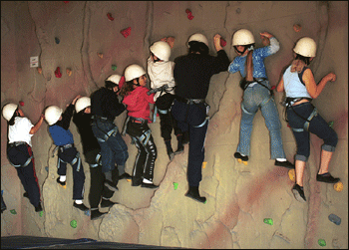
Programme of Events: Day 3
One further activity session in the morning
Lunch
Thank you ceremony
Leave Alton Castle at approximately 2pm.
Return to school at approximately 2.45- 3p.m.
Children can be collected immediately

Slide 12
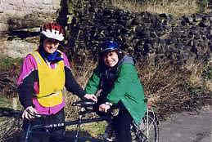
Activities
The Castle offers an excellent range of indoor and outdoor activities, including:
Orienteering
Off-road biking
Rock-climbing (indoor)
Survival skills
Astronomy
Art
Music
Children are supervised by qualified, first-aid trained staff at all times and appropriate safety gear is provided where necessary
Children are encouraged to fully utilise the excellent facilities in order to maximise their experience- though they will not be put under any pressure to participate

Slide 13
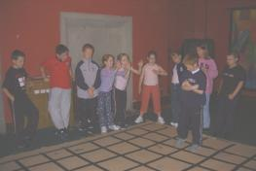
The Catholic Ethos
There is a prevalent theme of spirituality at the Castle, and children are encouraged to show respect to one another and to God at all times
Children will be encouraged to talk openly about their faith and explore their beliefs and feelings honestly and truthfully
Religious worship is creatively integrated at the Castle through drama, symbolism, music, art, reading, meditations/ reflections and of course, the Mass and prayer services

Slide 14
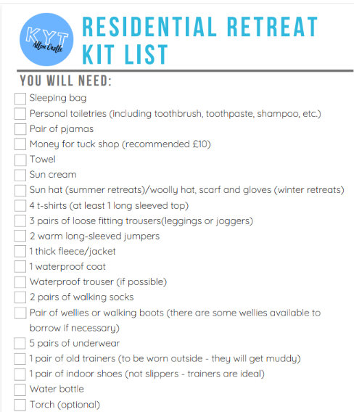

Slide 15

Thank you for your support!

