Slide 1
St. Mary’s Catholic Academy
November 2024
Messenger

Slide 2
Dear parents/carers,
Welcome back to a new half term. The children have all come back to school with great enthusiasm and a great attitude to learning, which is as always great to see.
On Monday 11th November the Catholic church honours St. Martin of Tours, he was soldier who left his post in the Roman army to become a “soldier of Christ” as a monk and later bishop. We will come together to commemorate Armistice Day. The children and staff will take part in prayer and a two-minute silence.
Also on Monday 11th November we will also begin our anti-bullying week. The national theme for the week this year is ‘Choose Respect’. On Tuesday 12th November, we will take part in ‘Odd Socks Day.’ You will be receiving further communication about how we are marking this week as a school.
On Thursday 21st November we will be holding a maths information morning and evening. This session will share the how we teach maths at school and how you can support this at home. Following this, on Friday 22nd November, there will be a watch me learn session where you can observe your child taking part in a maths lesson.
On Wednesday 27th November we will be holding our prospective parents’ session for the foundation stage at 2pm and 6pm. If your child will be 3 years old on the 1st September 2025, the applications can be made online via this link School admissions | Stoke-on-Trent. Similarly, the application process for the reception class is now open – this is for children who will be 4 on the 1st September 2025. Applications for the reception class need to be made directly through the authority and this closes on 15th January 2025.
Mrs D Statham
Head of School

Slide 3
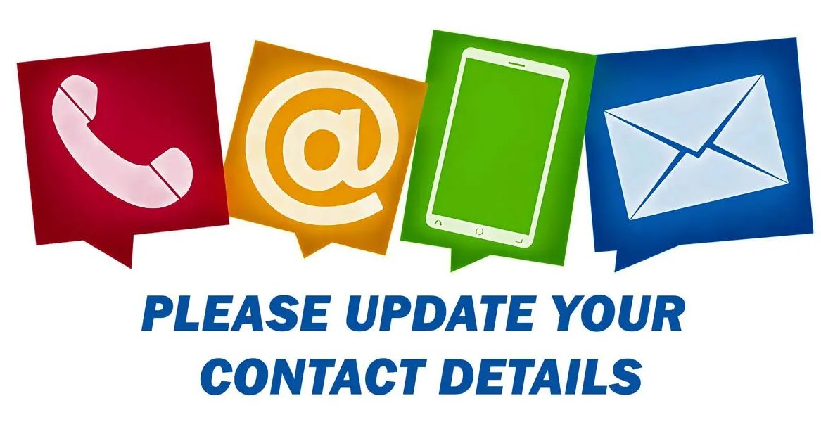
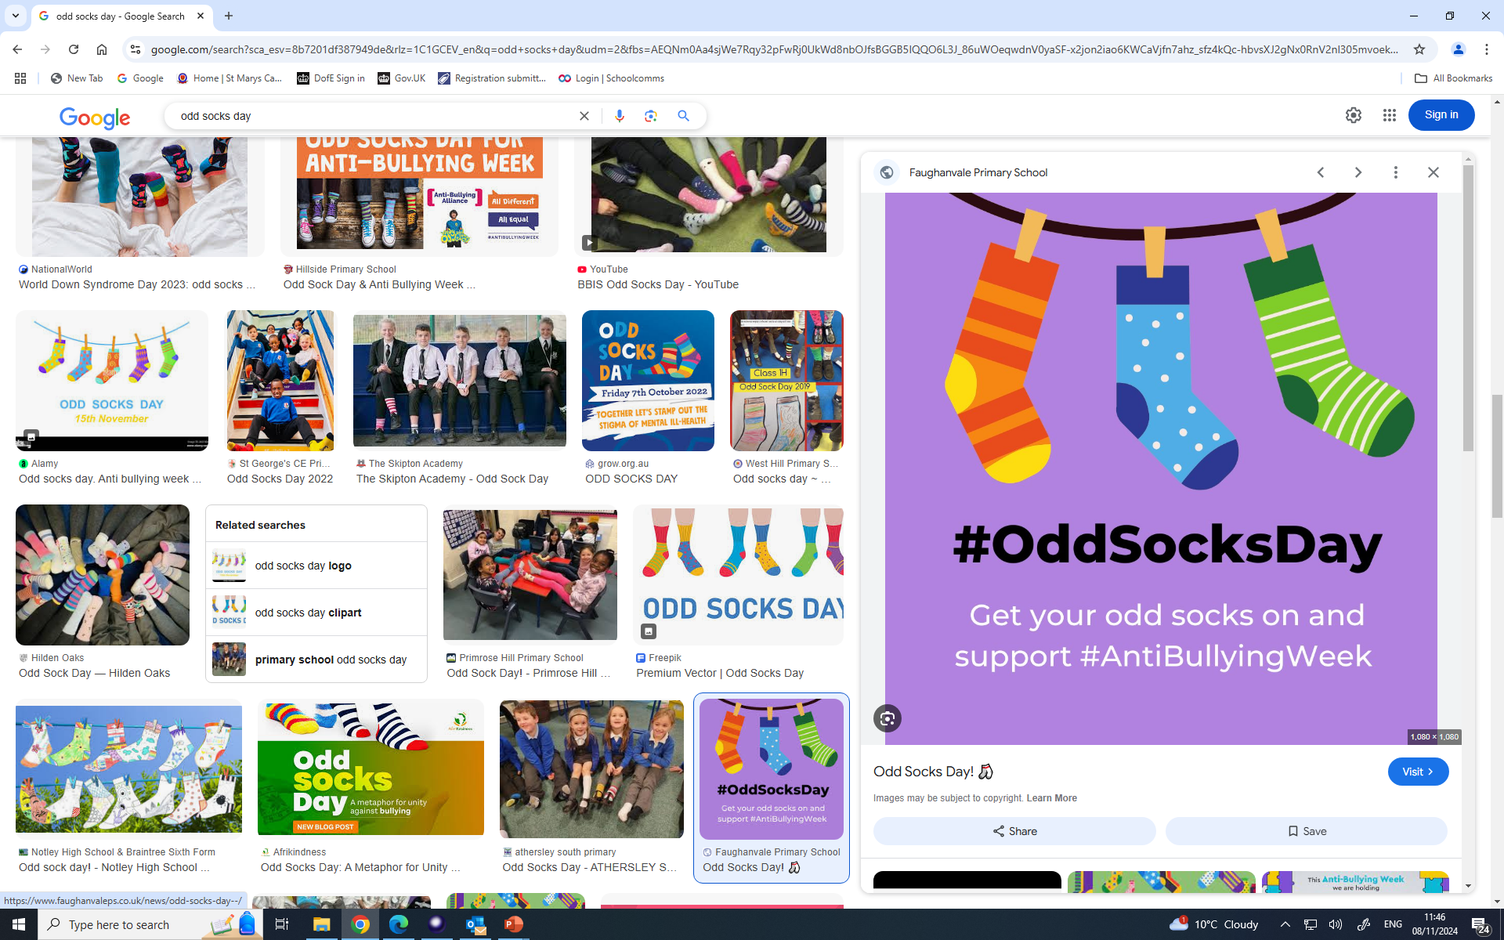



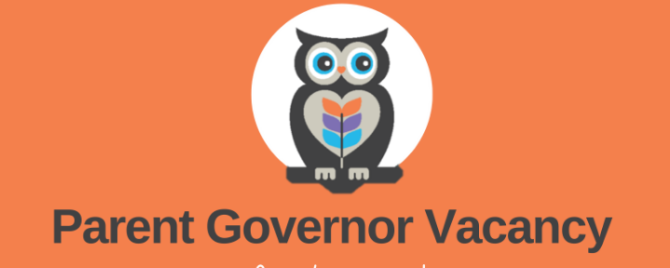
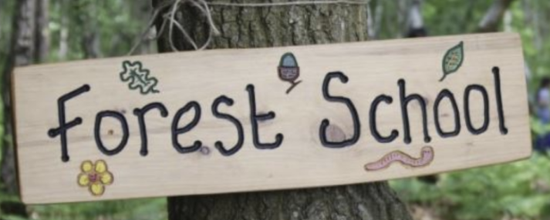
Please ensure that medical and dental appointments are booked outside of school hours where possible.
If an appointment is unavoidable please ensure your child is absent for a minimal amount of time from school.
If your child is absent from school
Please telephone the school on 01782 234820,
or email office@stmarysnewman.co.uk no later than 9.30am
Its important that we hold up to date information on our pupils.
Did you know that you are able to make changes to contact details on Arbor yourself?
All you need to do is log into the account and make the changes, we will receive notification of those changes and approve.
AUTUMN TERM
Inset day Monday 4th November
School opens to pupils Tuesday 5th November
School closes Friday 20th December
2024/25 dates are available on our website,
please click on the link below:
Term Dates 2024/2025 link
Tuesday 12th November
Our next St Mary’s family Mass is being held on
Sunday 1st December at 10am. It will be lovely to see you there.
https://www.stmarysstoke.co.uk/page/?title=School+Meals&pid=71
Our next St Mary’s family Mass is being held on
Sunday 1st December at 10am. It will be lovely to see you there.
Our menu has changed, please click on the link below to view this terms menu’s:
Autumn 2 menu
Please ensure that parental consent is completed by the deadline date, the school office spend time unnecessarily chasing confirmation of payment/consent.
This term’s curriculum will be uploaded to your
child's class page under ½ termly curriculum by Monday.
Please click on the link below which will
take you through to our website.
Class page link
We have a parent governor vacancy. If anyone is interested please submit a pen portrait to the school office (no more than 300 words) by Monday 2nd December. With a brief explanation of what skills you can bring to our governor board.
This half term Year 4 and Year 6 will take part in Forrest school.
Please ensure appropriate outdoor
clothing and footwear for wet/cold weather is brought into school every Wednesday.

Slide 4


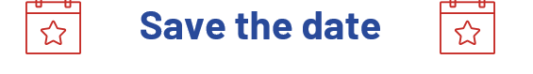
Awards/Celebrations
We would like to congratulate all of the children who have received awards
Year | Headteacher | Reading | Maths | Goldfinch
Reception | Ezra S | George K | Sydney A | Munachimso A
Year 1 | Vivienne K | Adha D | Chester S | Reggie D
Year 2 | Aurora L | Kirsten E-P | Connor H | Dottie G
Sunday 29th September and Sunday 1st December at 10am, it will be lovely to see you there.
Sunday 29th September and Sunday 1st December at 10am, it will be lovely to see you there.
Did you know that you can subscribe to our calendar?
All you need to do is click on the subscribe button - celebration assemblies and masses will appear on your selected device calendar. e.g Phone or tablet…
Polite reminder
We have a new time for celebration assemblies which is 9.05am
Celebration Assembly dates can be found on our website, on our calendar tab:
Calendar
** New date

Slide 5


